Slide 1

QuickLearning App
SPRING 2022 CAPSTONE PROJECT
GUIDED BY:- PROF HENRY WONG

Slide 2

Introduction
Brewing technologies is a team of six enthusiastic coders with 12 years of experience between the team working in the software development domain. This has enabled us to attain a diversified set of skills.

Slide 3
Roles & Responsibilities
AMIT BHAYAL - Business Analyst / SDE 2
ANKUSH GURHANI - Project Manager / SDE 2
GENIUS MACHADO - SDE
SHARANYA DAVE - DBA / SDE 3
SRAVANI EATA - Business Analyst
USHA TIRUMALASETTY - Software Tester / SDE 2

Slide 4


Problem Statement
Understanding the scope of the project
Market Analysis
Sprint Schedules
Tools & Technologies
Personas
Retrospective
OJECT DESCRIPTION
PERSONAS
TOOLS AND TECHNOLOGIES
MARKET ANALYSIS
SPRINT AND SCHEDULES
RETROSPECTIVE

Slide 5

Problem Statement
How Students and Parents know the objective of the subjects taught in the class ?
How the teachers and the student communicate with each other after the school hours ?
How the Parents monitor their kids assignments and learning material ?
How the current system can notify the user about any updates just in time ?

Slide 6
STAR ANALYSIS
SITUATION
TASK
ACTION
RESULT

Slide 7

PROJECT
DESCRIPTION

Slide 8
A learning management system (LMS) is a software that is designed specifically to create, distribute, and manage the delivery of educational content.
The LMS can be hosted as a stand-alone product on the company server, or it can be a cloud-based platform that is hosted by the software firm.
The goal of this project is knowledge management which means gathering, organizing, sharing and analysis of an organization's knowledge/resources.

Slide 9


Slide 10
AppName | Platform | Open Platform | Function
BlackBoard | Web and Mobile Application | yes | As a repository of information, i.e. course materials and course information but also used as a tool for communication through emails, announcements, discussion boards, and podcasts.
Canvas | Web and Mobile Application | yes | Canvas LMS simplifies teaching and learning activities and organizes coursework. Canvas Credentials empowers educators to own their professional development through digital badging.
Moodle | Web and Mobile Application | yes | It's secure and scalable, integrates seamlessly with third-party platforms and plugins, and allows teachers to create engaging, accessible, and active learning experiences.
Quick Learning | Web and Mobile Application | yes | Quick Learning is a software that is designed specifically to create, distribute and manage the delivery of educational content.

Slide 11
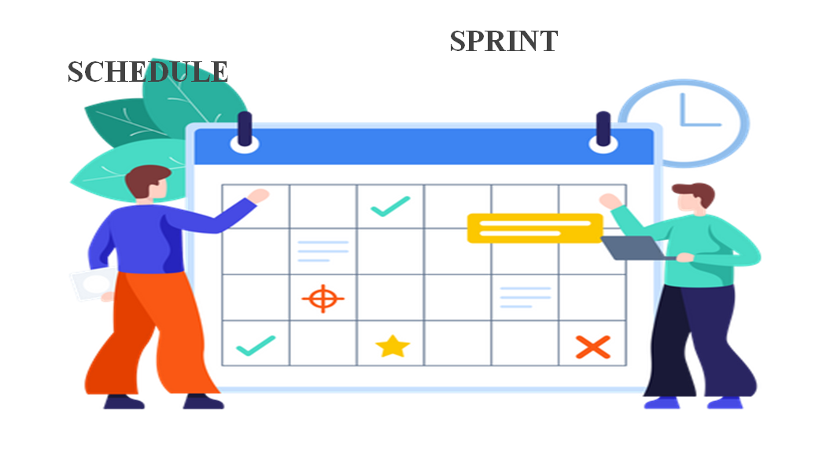

Slide 12
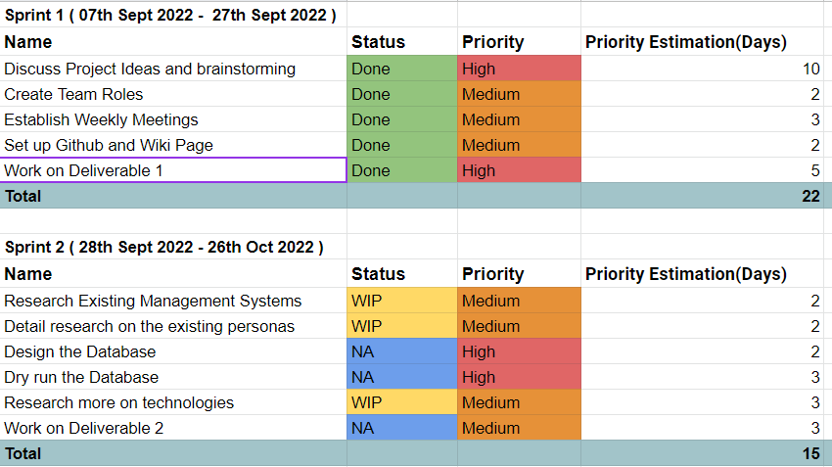

Slide 13
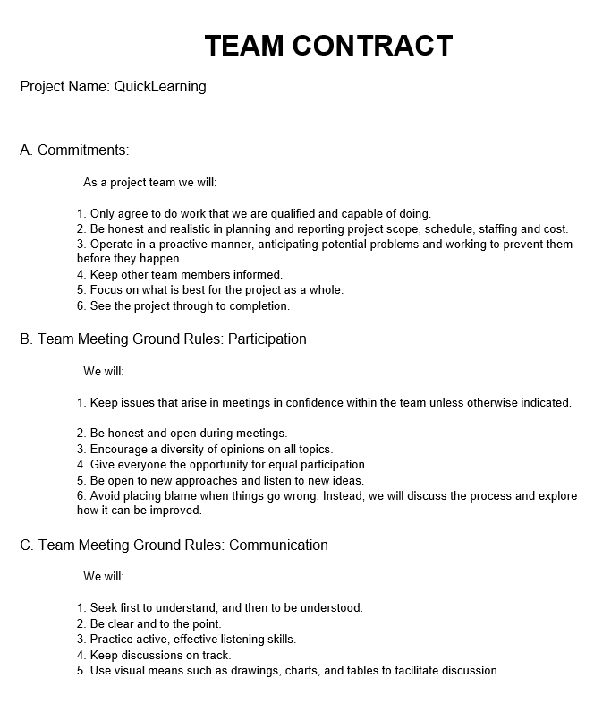
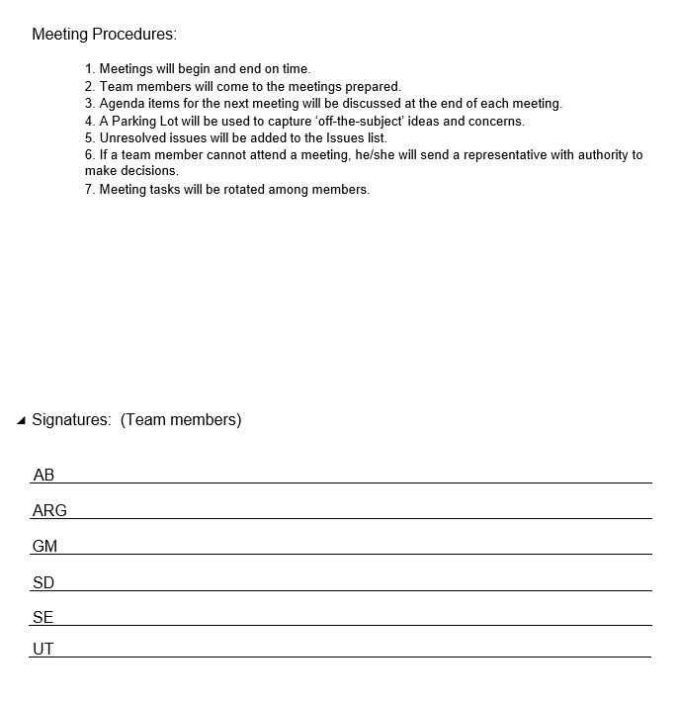

Slide 14






TECHNOLOGIES USED:
Front End Tools:
Back End Tools:

Slide 15

PERSONAS

Slide 16
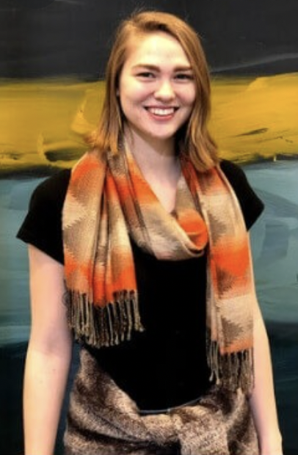
Persona -1:
Name :- Meghan
Job Role/Description :- Admin / Principal
Age :- 35
Meghan manages a team of 5 teachers and 200 students.
As the admin / Principal she assigns the task of the day to all the teacher, advising the student.
Ensuring a standard curriculum is being followed through the institute.
Providing resources for the teachers to update according to the changing market scenario.

Slide 17

Persona -2:
Persona :- David
Job Role/Description :- Teacher
Age :- 29
He is a teacher of the age 29 and teaches Mathematics.
As a teacher, it’s his responsibility to prepare lesson plans and make courses available to the students on time and collect deliverables from the student.
Also grading them accordingly in the given time frame.
Along with this he has to maintain the progress report of each student.
Prepare annually grade report for each student.

Slide 18

Persona -3:
Name :- Tyler
Role/Job Description :- Student
Age :- 18
Tyler is a 18-year-old student studying at the university.
As a student, it is his responsibility to manage his course work and keep track of his deadlines.
Meeting the requirements to receive the desired grades.
Completing a degree that will help him reach his career goal.
Getting accepted at his top choice of college.

Slide 19
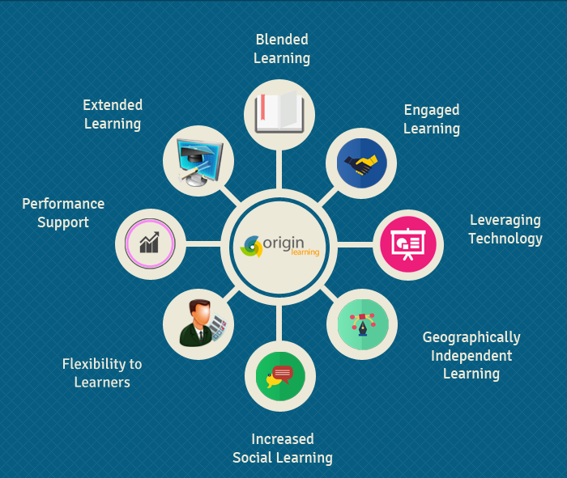

Slide 20

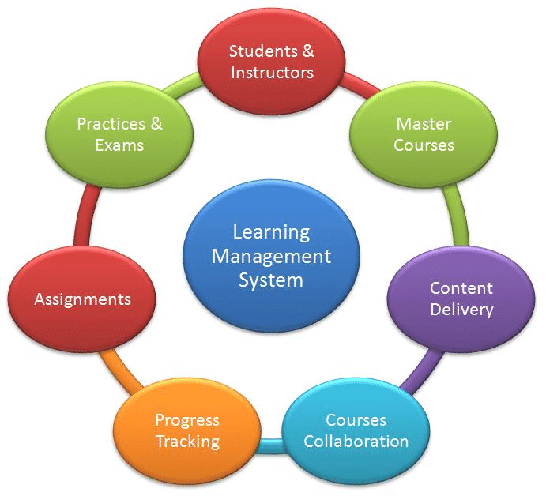
Utilities / Functionalities
Organizes Learning in A Single Location.
Tracking Learner’s Progress.
Reduces Training Costs.
Easy to Customize & Update.
Multimedia Learning.

Slide 21


Slide 22
WHAT WENT WELL ?
We collected useful and relevant background information for the project
Each of the team member contributed the ideas for the project.
The goals were defined and responsibilities were taken care of.
We did our research on all the topics including the tools and technologies used.
Team meeting were conducted in the timely manner.

Slide 23
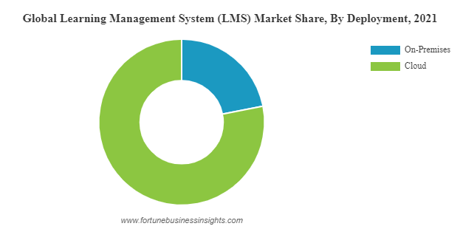
WHAT NEEDS IMPROVEMENT ?
Creating a periodic schedule to better coordinate parallel workflows in the team.
Work on more ways to consolidate the information we collected individually.

Slide 24

Future Enhancements
Microlearning
Gamification
Making the content available offline
Social and collaborative learning

Slide 25
Conclusion
Wiki Page Link https://github.com/BrewingTechnologies/BrewingTechnologies/wiki

